Slide 1
Quaternions and 3D Rotation
Lukas Goodman

Slide 2
Agenda
Some Things Spinning
How Do We Rotate Things on Paper?
What About Off The Page?
Why Aren’t They Spinning Right?
Quaternions

Slide 3
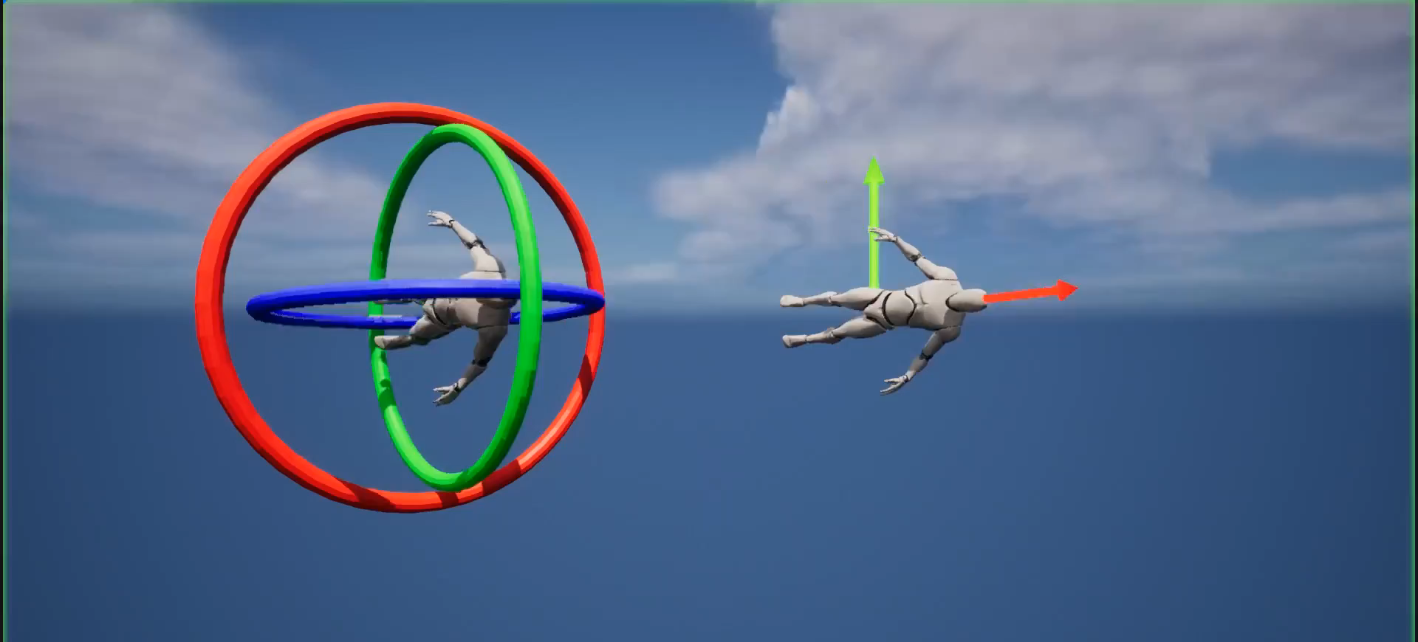
Notes:
This is a video displaying the ability for objects to lose a complete degree of rotation when using our standard Euler Rotations. On the right though model which uses an alternate method of storing orientation that avoids this issue.

Slide 4
2-D Rotation
Notes:
Before we start, let’s review methods of rotation in two dimensions

Slide 5

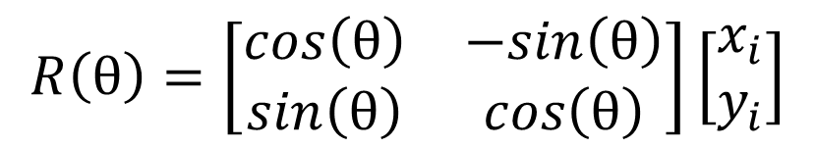

Matrices
$$x_{f}=x_{i}cos{θ}−y_{i}sin{θ}$$
$$R\left(θ\right)=\left[\begin{matrix}cos\left(θ\right) & −sin\left(θ\right) \\ sin\left(θ\right) & cos\left(θ\right)\end{matrix}\right]\left[\begin{matrix}x_{i} \\ y_{i}\end{matrix}\right]$$
$$y_{f}=x_{i}sin{θ}+y_{i}cos{θ}$$
Notes:
First, Matrices
To rotate a 2-D vector with a matrix, we use a rotation matrix and plug in our angle of rotation
Then we perform a matrix vector multiply to result in 2 Equations that we can use to find the resulting x and y components of our object

Slide 6




Complex Numbers
$$\left(cos\left(θ\right)+i\sin\left(θ\right)\right)(x_{i}+iy_{i})$$
$$x_{f}=x_{i}cos{θ}−y_{i}sin{θ}$$
$$i=\sqrt{−1}$$
$$y_{f}=x_{i}sin{θ}+y_{i}cos{θ}$$
Notes:
We can also rotate in 2D with complex numbers
To do so, we use a polar representation of a complex number, plugging in our angle of rotation
Then we multiply this by a complex number representation of our position to end up with our resulting x and y positions

Slide 7




Resulting Equations
Matrices
Complex Numbers
$$x_{f}=x_{i}cos{θ}−y_{i}sin{θ}$$
$$x_{f}=x_{i}cos{θ}−y_{i}sin{θ}$$
$$y_{f}=x_{i}sin{θ}+y_{i}cos{θ}$$
$$y_{f}=x_{i}sin{θ}+y_{i}cos{θ}$$
Notes:
Comparing the two resulting sets of equations, we can see that they are identical. This is expected and works fine for any and all angles since we are only rotating about one axis of rotation.

Slide 8
3-D Rotation
Notes:
Now, lets begin looking at rotating objects in three dimensions

Slide 9

Ways To Rotate in 3 Dimensions
Matrices
$R_{z}\left(γ\right)=\left[\begin{matrix}\cos{(γ)} & −\sin{(γ)} & 0 \\ \sin{(γ)} & \cos{(γ)} & 0 \\ 0 & 0 & 1\end{matrix}\right]$ $R_{y}\left(β\right)=\left[\begin{matrix}\cos{(β)} & 0 & \sin{(β)} \\ 0 & 1 & 0 \\ −\sin{(β)} & 0 & \cos{(β)}\end{matrix}\right]$
$$R_{x}\left(α\right)=\left[\begin{matrix}1 & 0 & 0 \\ 0 & \cos{(α)} & −\sin{(α)} \\ 0 & \sin{(α)} & \cos{(α)}\end{matrix}\right]$$
Notes:
Matrices in three dimensions
Three Euler rotation matrices to represent a rotation about each of the three standard euler axes

Slide 10
Ways To Rotate in 3 Dimensions
Matrices
$$R_{z}\left(γ\right){ R}_{y}\left(β\right){ R}_{x}\left(α\right)=\left[\begin{matrix}\cos\left(γ\right)\cos\left(β\right) & \cos\left(γ\right)\sin\left(β\right)\sin\left(α\right)−\sin\left(γ\right)\cos\left(α\right) & \cos\left(γ\right)\sin\left(β\right)\cos\left(α\right)+\sin\left(γ\right)\sin\left(α\right) \\ \sin\left(γ\right)\cos\left(β\right) & \sin\left(γ\right)\sin\left(β\right)\sin\left(α\right)+\cos\left(γ\right)\cos\left(α\right) & \sin\left(γ\right)\sin\left(β\right)\cos\left(α\right)−\cos\left(γ\right)\sin\left(α\right) \\ −\sin\left(β\right) & \cos\left(β\right)\sin\left(α\right) & \cos\left(β\right)\cos\left(α\right)\end{matrix} \right]$$
Notes:
We can then multiply them together to get a comprehensive rotation matrix to apply to an object
After that, we can, again, perform a vector matrix multiply on that matrix to give us…

Slide 11
Resulting Equations
Matrices
$$x_{f}=x_{i}\left(\cos\left(γ\right)\cos\left(β\right)\right)−y_{i}\left(\cos\left(γ\right)\sin\left(β\right)\sin\left(α\right)−\sin\left(γ\right)\cos\left(α\right)\right)+z_{i}\left(\cos\left(γ\right)\sin\left(β\right)\cos\left(α\right)+\sin\left(γ\right)\sin\left(α\right)\right)$$
$$y_{f}=x_{i}\left(\sin\left(γ\right)\cos\left(β\right)\right)+y_{i}\left(\sin\left(γ\right)\sin\left(β\right)\sin\left(α\right)+\cos\left(γ\right)\cos\left(α\right)\right)+z_{i}\left(\sin\left(γ\right)\sin\left(β\right)\cos\left(α\right)−\cos\left(γ\right)\sin\left(α\right)\right)$$
$$z_{f}=−x_{i}\left(\sin\left(β\right)\right)+y_{i}\left(\cos\left(β\right)\sin\left(α\right)\right)+z_{i}\left(\cos\left(β\right)\cos\left(α\right)\right)$$
Notes:
Resulting equations to use to find the orientation of an object after rotation

Slide 12
Why Aren’t They Spinning Right?
Notes:
If can rotate objects that way, why did we see the model on the left of the video rotating incorrectly

Slide 13

Rotation Matrices
Matrices
$R_{z}\left(γ\right)=\left[\begin{matrix}\cos{(γ)} & −\sin{(γ)} & 0 \\ \sin{(γ)} & \cos{(γ)} & 0 \\ 0 & 0 & 1\end{matrix}\right]$ $R_{y}\left(β\right)=\left[\begin{matrix}\cos{(β)} & 0 & \sin{(β)} \\ 0 & 1 & 0 \\ −\sin{(β)} & 0 & \cos{(β)}\end{matrix}\right]$
$$R_{x}\left(α\right)=\left[\begin{matrix}1 & 0 & 0 \\ 0 & \cos{(α)} & −\sin{(α)} \\ 0 & \sin{(α)} & \cos{(α)}\end{matrix}\right]$$
Notes:
Returning to our Euler Rotation Matrices
If we take our Euler Rotations…

Slide 14
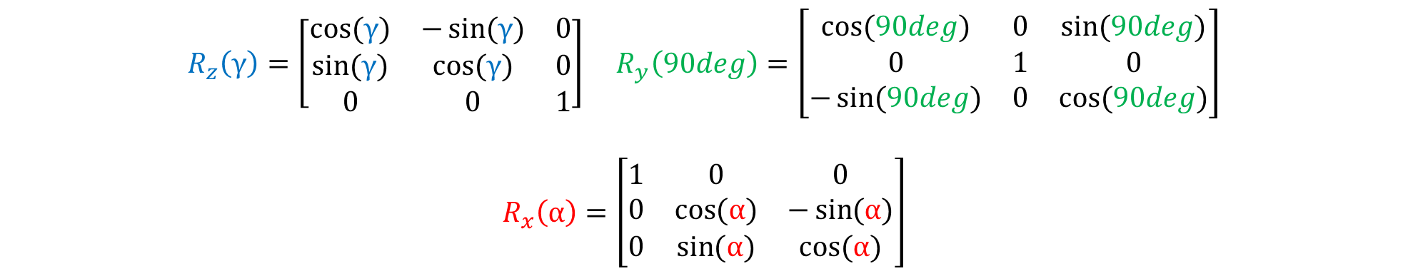
Matrix Composition
Matrices
$R_{z}\left(γ\right)=\left[\begin{matrix}\cos{(γ)} & −\sin{(γ)} & 0 \\ \sin{(γ)} & \cos{(γ)} & 0 \\ 0 & 0 & 1\end{matrix}\right]$ $R_{y}\left(90deg\right)=\left[\begin{matrix}\cos{(90deg)} & 0 & \sin{(90deg)} \\ 0 & 1 & 0 \\ −\sin{(90deg)} & 0 & \cos{(90deg)}\end{matrix}\right]$
$$R_{x}\left(α\right)=\left[\begin{matrix}1 & 0 & 0 \\ 0 & \cos{(α)} & −\sin{(α)} \\ 0 & \sin{(α)} & \cos{(α)}\end{matrix}\right]$$
Notes:
And arbitrarily rotate about the y axis by 90 degrees

Slide 15
Here’s The Problem
Matrices
$$R_{z}\left(γ\right){ R}_{y}\left(β\right){ R}_{x}\left(α\right)=\left[\begin{matrix}0 & sin⁡(α−γ) & cos⁡(α−γ) \\ 0 & cos⁡(α−γ) & −sin⁡(α−γ) \\ 1 & 0 & 0\end{matrix} \right]$$
Notes:
We instead get a comprehensive rotation matrix that looks like this
There are two important things about this matrix specifically
it is essentially a 2D Rotation matrix
alpha and gamma have the same effect on it

Slide 16
Ways To Rotate in 3 Dimensions
Matrices
$$R_{z}\left(γ\right){ R}_{y}\left(β\right){ R}_{x}\left(α\right)=\left[\begin{matrix}\cos\left(γ\right)\cos\left(β\right) & \cos\left(γ\right)\sin\left(β\right)\sin\left(α\right)−\sin\left(γ\right)\cos\left(α\right) & \cos\left(γ\right)\sin\left(β\right)\cos\left(α\right)+\sin\left(γ\right)\sin\left(α\right) \\ \sin\left(γ\right)\cos\left(β\right) & \sin\left(γ\right)\sin\left(β\right)\sin\left(α\right)+\cos\left(γ\right)\cos\left(α\right) & \sin\left(γ\right)\sin\left(β\right)\cos\left(α\right)−\cos\left(γ\right)\sin\left(α\right) \\ −\sin\left(β\right) & \cos\left(β\right)\sin\left(α\right) & \cos\left(β\right)\cos\left(α\right)\end{matrix} \right]$$
Notes:
Comparing that to our standard comprehensive rotation matrix, we can see the obvious differences between the two

Slide 17
Here’s The Problem
Matrices
$$R_{z}\left(γ\right){ R}_{y}\left(β\right){ R}_{x}\left(α\right)=\left[\begin{matrix}0 & sin⁡(α−γ) & cos⁡(α−γ) \\ 0 & cos⁡(α−γ) & −sin⁡(α−γ) \\ 1 & 0 & 0\end{matrix} \right]$$

Slide 18
Quaternions
Notes:
There is hope though, we can use something called Quaternions to fix this issue

Slide 19




What is a Quaternion?
Quaternions
Complex Numbers
$$i,j,k=\sqrt{−1}$$
$$i=\sqrt{−1}$$
$q=t+ix+jy+kz$
$q=x+iy$
Notes:
A quaternion is a type of complex number. However, rather than our typical 2-dimensional complex number which has a single imaginary part, Quaternions have three imaginary parts

Slide 20

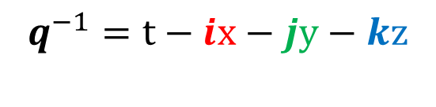

What is a Quaternion?
Complex Numbers: Quaternions
$$i,j,k=\sqrt{−1}$$
$q=t+ix+jy+kz$
$q^{−1}=t−ix−jy−kz$
Notes:
These imaginary parts are all equal to the square root of -1
Additionally, all three multiplied together are also equal to -1
Each quaternion also has a conjugate, a sort of inverse to it

Slide 21
Complex Numbers
$$\left(cos\left(θ\right)+i\sin\left(θ\right)\right)(x_{i}+iy_{i})$$
$$x_{f}=x_{i}cos{θ}−y_{i}sin{θ}$$
$$i=\sqrt{−1}$$
$$y_{f}=x_{i}sin{θ}+y_{i}cos{θ}$$
Notes:
Returning to complex numbers, we can see that they have a polar definition which uses both sin and cos as well as an imaginary number

Slide 22
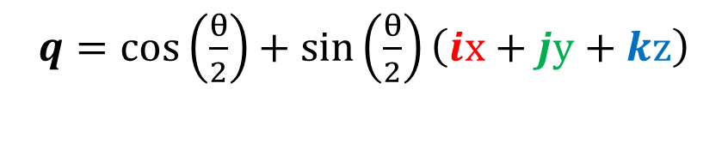
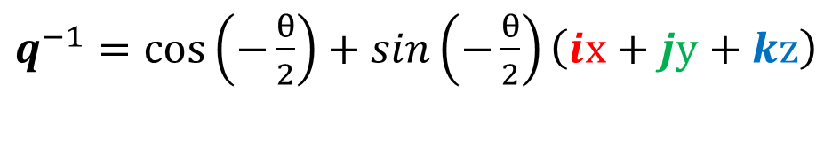
Polar Definition
Complex Numbers: Quaternions
$q=cos\left(\frac{θ}{2}\right)+\sin\left(\frac{θ}{2}\right)\left(ix+jy+kz\right)$
$q^{−1}=cos\left(−\frac{θ}{2}\right)+sin\left(−\frac{θ}{2}\right)\left(ix+jy+kz\right)$
Notes:
Quaternions also have a similar polar definition. However, importantly, the angle is halved

Slide 23



Rotation
Complex Numbers: Quaternions
$u=ix+jy+kz$
$p=ix_{p}+jy_{p}+kz_{p}$
$Rq=qpq^{−1}$
$Rq=$ $\left(cos\left(\frac{θ}{2}\right)+sin\left(\frac{θ}{2}\right)u\right) \left(p\right)\left(cos\left(−\frac{θ}{2}\right)+sin\left(−\frac{θ}{2}\right)u\right)$
Notes:
The reason why the angle is halved is at the crux of why we even care about quaternions at all.
A polar represented quaternion is a unique way of representing a rotation about an axis, defined by the scalars of the imaginary parts, by twice the angle shown.
This is because the way that that rotation is applied is by performing two fourth dimensional rotations
The first performs a fourth dimensional rotation, in which the angle of rotation is applied in 3 dimensions
The second then undoes the fourth dimensional part of the rotation while not only retaining but doubling the third dimensional part of it
Resulting in the 3-dimensional rotation we wanted
Don’t worry if that doesn’t really make any sense, the whole concept is a bit nonsensical. All we really care about is that this order of multiplying quaternions will result in the rotation that we need.

Slide 24
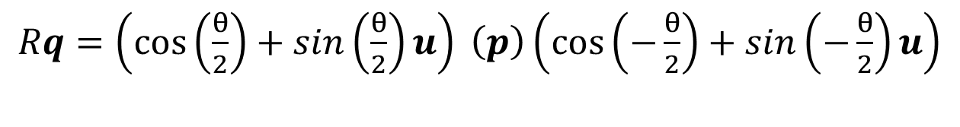
Rotation
Complex Numbers: Quaternions
$Rq=\left(cos\left(\frac{θ}{2}\right)+sin\left(\frac{θ}{2}\right)u\right) \left(p\right)\left(cos\left(−\frac{θ}{2}\right)+sin\left(−\frac{θ}{2}\right)u\right)$
$$Rq=p\left(\cos\left(θ\right)\right)+\left(u×p\right)\left(sin\left(θ\right)\right)+\left(u∙p\right)u− \left(u∙p\right)u\left(\cos\left(θ\right)\right)$$
Notes:
From this, and I’ll spare you the full proof, after multiplying this equation out, we get this nice equation
Those of you familiar with linear algebra will recognize the cross and dot products, which we are allowed to do because they are being done on axes of our quaternions which are essentially 3D vectors

Slide 25

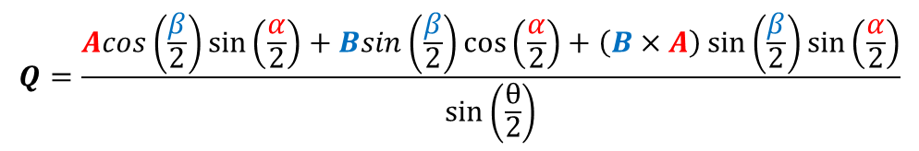
Ways To Rotate in 3 Dimensions
Complex Numbers: Quaternions
$$R_{b}R_{a}=R_{Q}=\cos\left(\frac{θ}{2}\right)+Q\sin\left(\frac{θ}{2}\right)$$
θ $=2\cos^{−1}\left(\cos\left(\frac{β}{2}\right)\cos\left(\frac{α}{2}\right)−\left(B∙A\right)\sin\left(\frac{β}{2}\right)\sin\left(\frac{α}{2}\right)\right)$
$$Q=\frac{Acos\left(\frac{β}{2}\right)\sin\left(\frac{α}{2}\right)+Bsin\left(\frac{β}{2}\right)\cos\left(\frac{α}{2}\right)+\left(B×A\right)\sin\left(\frac{β}{2}\right)\sin\left(\frac{α}{2}\right)}{\sin\left(\frac{θ}{2}\right)}$$
Notes:
Lastly, we can also combine quaternion rotations together. Multiplying quaternion Rb by Ra in their polar forms, we get a new quaternion which will be the same rotation as applying Rb then Ra.

Slide 26
What does this do for us?

Slide 27
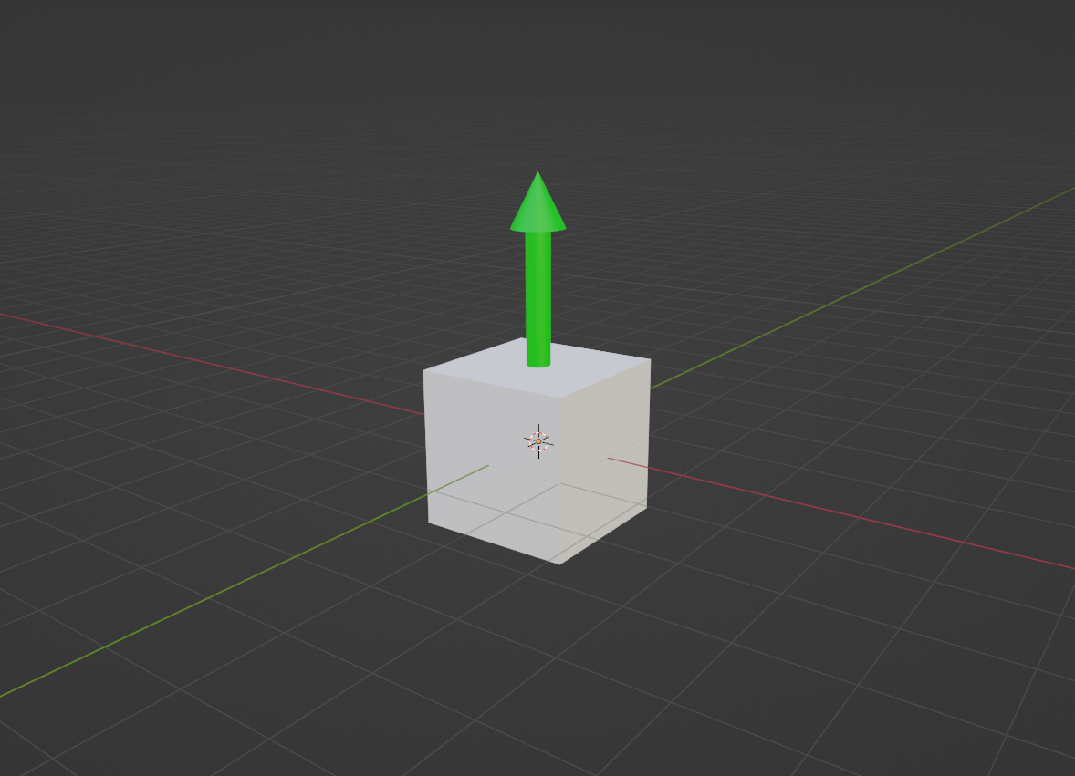

Rotation
$q=cos(0)+sin\left(0\right)\left(0i+0j+1z\right)$
Notes:
For every object that we need to orient in 3D space, we can give it a sort of Base Quaternion which represents no rotation at all

Slide 28
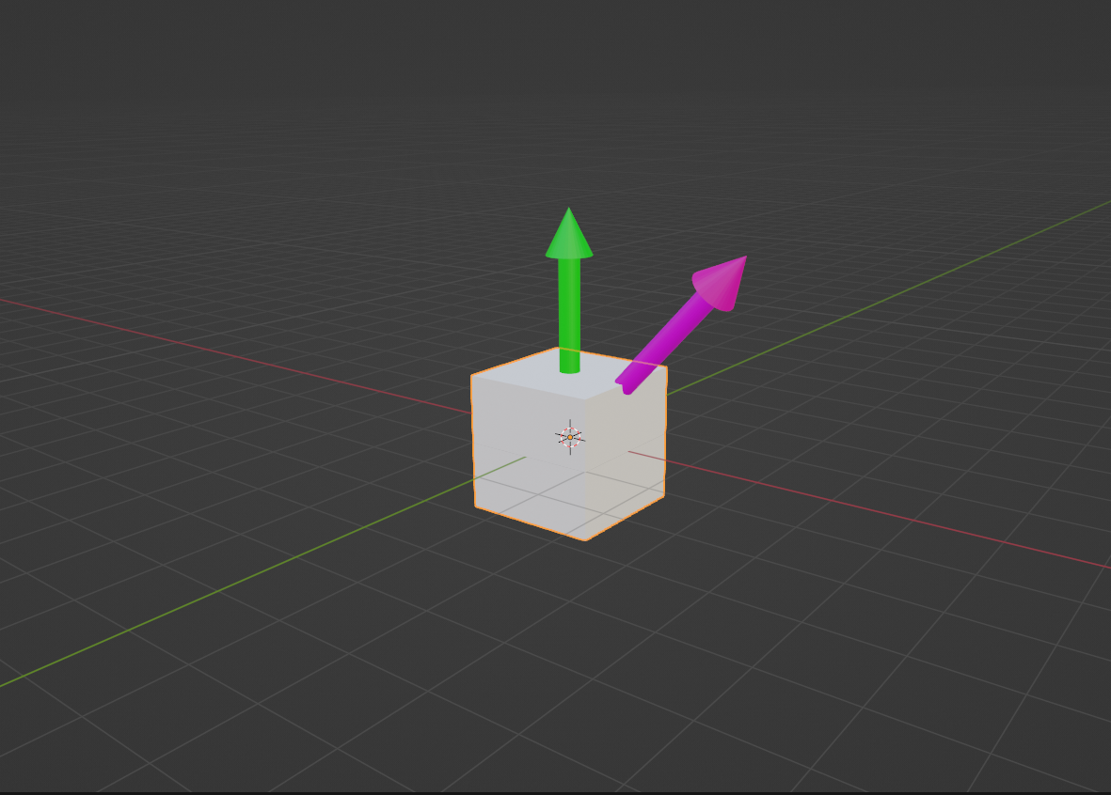
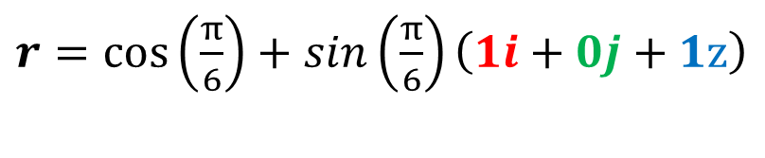

Rotation
$q=cos(0)+sin\left(0\right)\left(0i+0j+1z\right)$
$r=cos\left(\frac{π}{6}\right)+sin\left(\frac{π}{6}\right)\left(1i+0j+1z\right)$
Notes:
We can then perform rotations on the vector portion of that to get a new orientation quaternion that will be our final orientation for our object

Slide 29
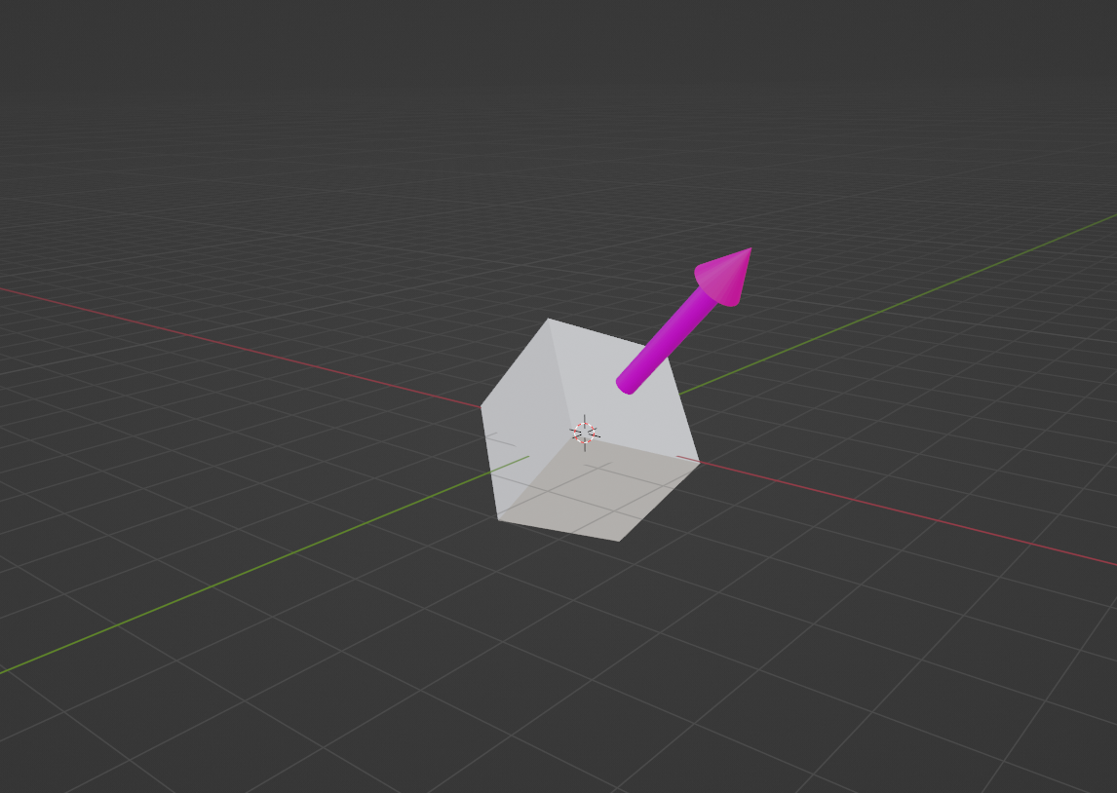
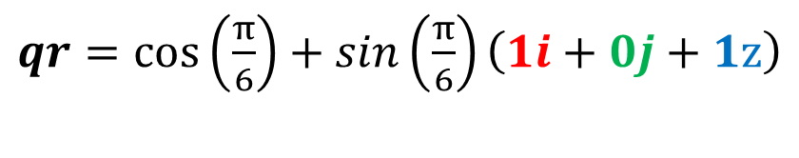


Rotation
$q=cos(0)+sin\left(0\right)\left(0i+0j+1z\right)$
$r=cos\left(\frac{π}{6}\right)+sin\left(\frac{π}{6}\right)\left(1i+0j+1z\right)$
$qr=cos\left(\frac{π}{6}\right)+sin\left(\frac{π}{6}\right)\left(1i+0j+1z\right)$
Notes:
Then, we can neatly interpolate between the two to smoothly rotate to our new orientation, completely eliminating the potential for Gimbal Lock to occur

Slide 30
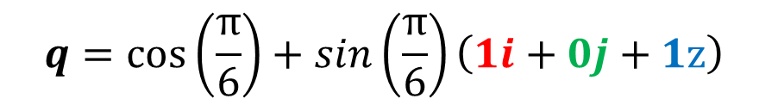
Rotation
$$q=cos\left(\frac{π}{6}\right)+sin\left(\frac{π}{6}\right)\left(1i+0j+1z\right)$$
Notes:
We then store that quaternion as our new orientation quaternion, which we can apply more rotations to as necessary

Slide 32
Thank you
Lukas Goodman

